Slide 1
Overview
Basics of Neural Network
Advanced Features of Neural Network
Applications I-II
Summary

Slide 2
Basics of Neural Network
What is a Neural Network
Neural Network Classifier
Data Normalization
Neuron and bias of a neuron
Single Layer Feed Forward
Limitation
Multi Layer Feed Forward
Back propagation

Slide 3

Neural Networks
What is a Neural Network?
Biologically motivated approach to machine learning
Similarity with biological network
Fundamental processing elements of a neural network is a neuron
1.Receives inputs from other source
2.Combines them in someway
3.Performs a generally nonlinear operation on the result
4.Outputs the final result

Slide 4
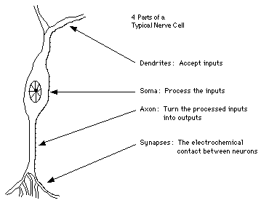
Similarity with Biological Network
Fundamental processing element of a
neural network is a neuron
A human brain has 100 billion neurons
An ant brain has 250,000 neurons

Slide 5
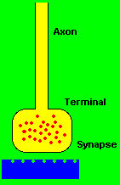
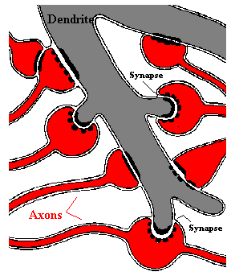
Synapses, the basis of learning and memory

Slide 6
Neural Network
Neural Network is a set of connected
INPUT/OUTPUT UNITS, where each connection has a WEIGHT associated with it.
Neural Network learning is also called CONNECTIONIST learning due to the connections between units.
It is a case of SUPERVISED, INDUCTIVE or CLASSIFICATION learning.

Slide 7
Neural Network
Neural Network learns by adjusting the weights so as to be able to correctly classify the training data and hence, after testing phase, to classify unknown data.
Neural Network needs long time for training.
Neural Network has a high tolerance to noisy and incomplete data

Slide 8
Neural Network Classifier
Input: Classification data
It contains classification attribute
Data is divided, as in any classification problem.
[Training data and Testing data]
All data must be normalized.
(i.e. all values of attributes in the database are changed to contain values in the internal [0,1] or[-1,1])
Neural Network can work with data in the range of (0,1) or (-1,1)
Two basic normalization techniques
[1] Max-Min normalization
[2] Decimal Scaling normalization

Slide 9
Data Normalization
[1] Max- Min normalization formula is as follows:
[minA, maxA , the minimun and maximum values of the attribute A
max-min normalization maps a value v of A to v’ in the range {new_minA, new_maxA} ]

Slide 10
Example of Max-Min Normalization
Max- Min normalization formula
Example: We want to normalize data to range of the interval [0,1].
We put: new_max A= 1, new_minA =0.
Say, max A was 100 and min A was 20 ( That means maximum and minimum values for the attribute ).
Now, if v = 40 ( If for this particular pattern , attribute value is 40 ), v’ will be calculated as , v’ = (40-20) x (1-0) / (100-20) + 0
=> v’ = 20 x 1/80
=> v’ = 0.4

Slide 11
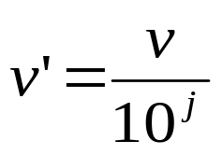
Decimal Scaling Normalization
[2]Decimal Scaling Normalization
Normalization by decimal scaling normalizes by moving the decimal point of values of attribute A.
Here j is the smallest integer such that max|v’|<1.
Example :
A – values range from -986 to 917. Max |v| = 986.
v = -986 normalize to v’ = -986/1000 = -0.986

Slide 12
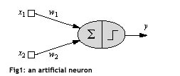
One Neuron as a Network
Here x1 and x2 are normalized attribute value of data.
y is the output of the neuron , i.e the class label.
x1 and x2 values multiplied by weight values w1 and w2 are input to the neuron x.
Value of x1 is multiplied by a weight w1 and values of x2 is multiplied by a weight w2.
Given that
  w1 = 0.5 and w2 = 0.5
  Say value of x1 is 0.3 and value of x2 is 0.8,
  So, weighted sum is :
  sum= w1 x x1 + w2 x x2 = 0.5 x 0.3 + 0.5 x 0.8 = 0.55

Slide 13
One Neuron as a Network
  The neuron receives the weighted sum as input and calculates the output as a function of input as follows :
  y = f(x) , where f(x) is defined as
  f(x) = 0 { when x< 0.5 }
  f(x) = 1 { when x >= 0.5 }
  For our example, x ( weighted sum ) is 0.55, so y = 1 ,
  That means corresponding input attribute values are classified in class 1.
  If for another input values , x = 0.45 , then f(x) = 0,
  so we could conclude that input values are classified to class 0.

Slide 14
Bias of a Neuron
We need the bias value to be added to the weighted sum ∑wixi so that we can transform it from the origin.
        v = ∑wixi + b, here b is the bias
x1-x2= -1
x2
x1-x2=0
x1-x2= 1
x1

Slide 15



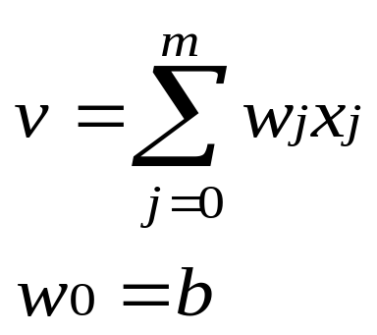
Bias as extra input
x₀ = +1
w₀
x₁
W1
Activation
function
v
Input
Attribute
values
Output
class
y
x₂
w₂
Summing function
x_{m}
w_{m}
weights

Slide 16
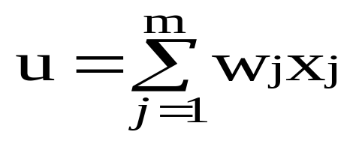
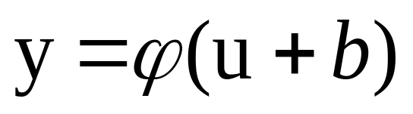
Neuron with Activation
The neuron is the basic information processing unit of a NN. It consists of:
  1 A set of links, describing the neuron inputs, with weights W₁, W₂, …, W_{m}
  2. An adder function (linear combiner) for computing the weighted sum of the inputs (real numbers):
  3 Activation function : for limiting the amplitude of the neuron output.

Slide 17

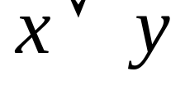
Why We Need Multi Layer ?
Linear Separable:
Linear inseparable:
Solution?

Slide 18
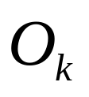

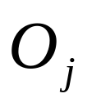
A Multilayer Feed-Forward Neural Network
Output Class
Output nodes
Hidden nodes
w_{ij}
- weights
Input nodes
Network is fully connected
Input Record : x_{i}

Slide 19
Neural Network Learning
The inputs are fed simultaneously into the input layer.
The weighted outputs of these units are fed into hidden layer.
The weighted outputs of the last hidden layer are inputs to units making up the output layer.

Slide 20
A Multilayer Feed Forward Network
The units in the hidden layers and output layer are sometimes referred to as neurodes, due to their symbolic biological basis, or as output units.
A network containing two hidden layers is called a three-layer neural network, and so on.
The network is feed-forward in that none of the weights cycles back to an input unit or to an output unit of a previous layer.

Slide 21
A Multilayered Feed – Forward Network
INPUT: records without class attribute with normalized attributes values.
INPUT VECTOR: X = { x1, x2, …. xn}
where n is the number of (non class) attributes.
INPUT LAYER – there are as many nodes as non-class attributes i.e. as the length of the input vector.
HIDDEN LAYER – the number of nodes in the hidden layer and the number of hidden layers depends on implementation.

Slide 22
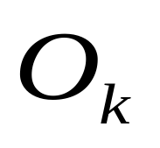
A Multilayered Feed–Forward Network
OUTPUT LAYER – corresponds to the class attribute.
There are as many nodes as classes (values of the class attribute).
k= 1, 2,.. #classes
Network is fully connected, i.e. each unit provides input
to each unit in the next forward layer.

Slide 23
Classification by Back propagation
Back Propagation learns by iteratively processing a set of training data (samples).
For each sample, weights are modified to minimize the error between network’s classification and actual classification.

Slide 24
Steps in Back propagation Algorithm
STEP ONE: initialize the weights and biases.
The weights in the network are initialized to random numbers from the interval [-1,1].
Each unit has a BIAS associated with it
The biases are similarly initialized to random numbers from the interval [-1,1].
STEP TWO: feed the training sample.

Slide 25
Steps in Back propagation Algorithm
( cont..)
STEP THREE: Propagate the inputs forward; we compute the net input and output of each unit in the hidden and output layers.
STEP FOUR: back propagate the error.
STEP FIVE: update weights and biases to reflect the propagated errors.
STEP SIX: terminating conditions.

Slide 26
Propagation through Hidden Layer ( One Node )
-
Bias Θj
x₀
w_{0j}
x₁
w_{1j}
∑
f
output y
x_{n}
w_{nj}
Input
vector x
weight
vector w
weighted
sum
Activation
function
The inputs to unit j are outputs from the previous layer. These are multiplied by their corresponding weights in order to form a weighted sum, which is added to the bias associated with unit j.
A nonlinear activation function f is applied to the net input.

Slide 27
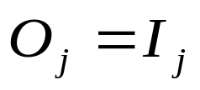
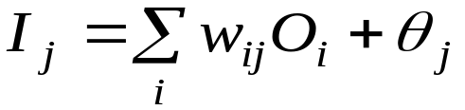

Propagate the inputs forward
For unit j in the input layer, its output is equal to its input, that is,
for input unit j.
The net input to each unit in the hidden and output layers is computed as follows.
Given a unit j in a hidden or output layer, the net input is
where wij is the weight of the connection from unit i in the previous layer to unit j; Oi is the output of unit I from the previous layer;
is the bias of the unit

Slide 28
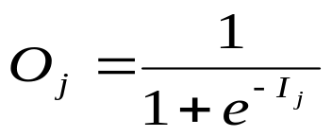
Propagate the inputs forward
Each unit in the hidden and output layers takes its net input and then applies an activation function. The function symbolizes the activation of the neuron represented by the unit. It is also called a logistic, sigmoid, or squashing function.
Given a net input Ij to unit j, then
Oj = f(Ij),
the output of unit j, is computed as

Slide 29
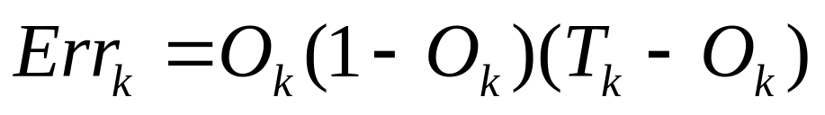
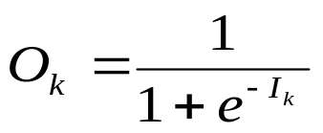
Back propagate the error
When reaching the Output layer, the error is computed and propagated backwards.
For a unit k in the output layer the error is computed by a formula:
Where O k – actual output of unit k ( computed by activation function.
Tk – True output based of known class label; classification of training sample
Ok(1-Ok) – is a Derivative ( rate of change ) of activation function.

Slide 30

Back propagate the error
The error is propagated backwards by updating weights and biases to reflect the error of the network classification .
For a unit j in the hidden layer the error is computed by a formula:
where wjk is the weight of the connection from unit j to unit k in the next higher layer, and Errk is the error of unit k.

Slide 31
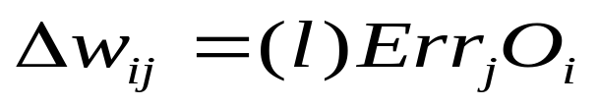
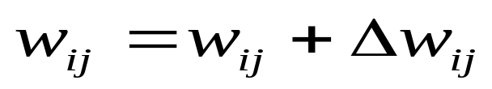
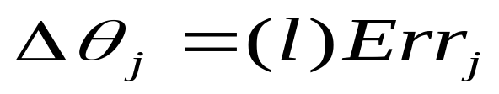
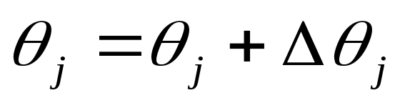
Update weights and biases
Weights are updated by the following equations, where l is a constant between 0.0 and 1.0 reflecting the learning rate, this learning rate is fixed for implementation.
Biases are updated by the following equations

Slide 32
Update weights and biases
We are updating weights and biases after the presentation of each sample.
This is called case updating.
Epoch --- One iteration through the training set is called an epoch.
Epoch updating ------------
Alternatively, the weight and bias increments could be accumulated in variables and the weights and biases updated after all of the samples of the training set have been presented.
Case updating is more accurate

Slide 33
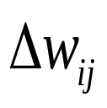
Terminating Conditions
Training stops
All
in the previous epoch are below some threshold, or
The percentage of samples misclassified in the previous epoch is below some threshold, or
a pre specified number of epochs has expired.
In practice, several hundreds of thousands of epochs may be required before the weights will converge.

Slide 34
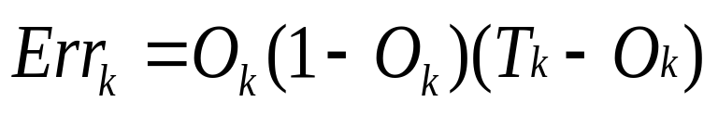


Backpropagation Formulas
Output vector
Output nodes
Hidden nodes
w_{ij}
Input nodes
Input vector: x_{i}

Slide 35
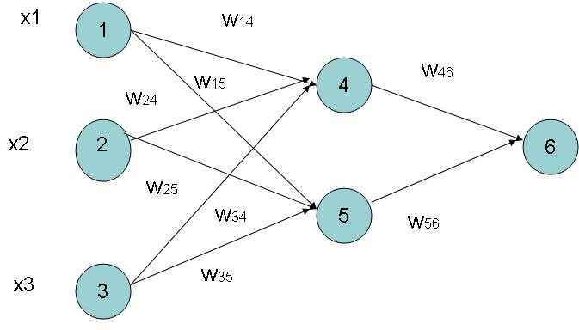
Example of Back propagation
Input = 3, Hidden Neuron = 2 Output =1
Initialize weights :
Random Numbers from -1.0 to 1.0
Initial Input and weight
x1 | x2 | x3 | w14 | w15 | w24 | w25 | w34 | w35 | w46 | w56
1 | 0 | 1 | 0.2 | -0.3 | 0.4 | 0.1 | -0.5 | 0.2 | -0.3 | -0.2

Slide 36
Example ( cont.. )
Bias added to Hidden
+ Output nodes
Initialize Bias
Random Values from
-1.0 to 1.0
Bias ( Random )
θ4 | θ5 | θ6
-0.4 | 0.2 | 0.1

Slide 37
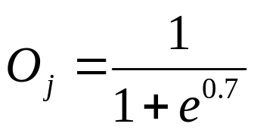
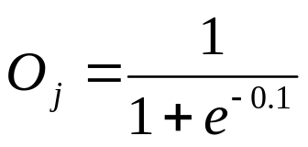
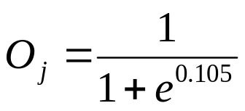
Net Input and Output Calculation
Unitj | Net Input Ij | Output Oj
4 | 0.2 + 0 + 0.5 -0.4 = -0.7
5 | -0.3 + 0 + 0.2 + 0.2 =0.1
6 | (-0.3)0.332-(0.2)(0.525)+0.1= -0.105
= 0.332
= 0.525
= 0.475

Slide 38
Calculation of Error at Each Node
Unit j | Error j
6 | 0.475(1-0.475)(1-0.475) =0.1311 We assume T 6 = 1
5 | 0.525 x (1- 0.525)x 0.1311x (-0.2) = 0.0065
4 | 0.332 x (1-0.332) x 0.1311 x (-0.3) = -0.0087

Slide 39
Calculation of weights and Bias Updating
Learning Rate l =0.9
Weight | New Values
w46 | -0.3 + 0.9(0.1311)(0.332) = -0.261
w56 | -0.2 + (0.9)(0.1311)(0.525) = -0.138
w14 | 0.2 + 0.9(-0.0087)(1) = 0.192
w15 | -0.3 + (0.9)(-0.0065)(1) = -0.306
……..similarly | ………similarly
θ6 | 0.1 +(0.9)(0.1311)=0.218
……..similarly | ………similarly

Slide 40
Network Pruning and Rule Extraction
Network pruning
  Fully connected network will be hard to articulate
  N input nodes, h hidden nodes and m output nodes lead to h(m+N) weights
  Pruning: Remove some of the links without affecting classification accuracy of the network

Slide 41
Advanced Features of Neural Network
Training with Subsets
Modular Neural Network
Evolution of Neural Network

Slide 42
Variants of Neural Networks Learning
Supervised learning/Classification
  Control
  Function approximation
  Associative memory
Unsupervised learning or Clustering

Slide 43
Training with Subsets
Select subsets of data
Build new classifier on subset
Aggregate with previous classifiers
Compare error after adding classifier
Repeat as long as error decreases
Notes:
Error after adding each classifier compared against the previous error
– process repeats as long as the error decreases
He suggested two mechanisms for pasting votes
Pasting Rvotes (Random Votes)
Simple approach -- each example has equal probability of getting selected
A method for creating an ensemble classifier in a small number of passes through data
Pasting Ivotes (Important Votes)
Select the examples based on whether the out-of-bag classifier classifies them correctly
An out0of-bag classifier is constructed by first forming bootstrap training sets and
collecting the bagging predictor votes from the examples omitted by the bootstrap sample
Pasting Ivotes proves to be a more accurate method
Similarity – entire database is never in main memory at a time
Difference – we are able to use all of the data in building a single classifier
A single classifier – possibly a more accurate single classifier and faster too..
We also need only random access to the data on disk

Slide 44
Training with subsets
Subset 1
NN 1
Subset 2
NN 2
The
Whole
Dataset
Split the dataset
into subsets
that can fit
into memory
Subset 3
NN 3
.
.
.
Subset n
NN n
A Single
Neural Network
Model
Notes:
Break the data into subsets, that can fit in memory
Train one neural network on a series of the subsets
The result is a single neural network model
In this way, we attempt to overcome the difficulty addressed by catlett,
making use of all the available data, without leaving anything

Slide 45
Modular Neural Network
Modular Neural Network
  Made up of a combination of several neural networks.
  The idea is to reduce the load for each neural network as opposed to trying to solve the problem on a single neural network.
Notes:
Error after adding each classifier compared against the previous error
– process repeats as long as the error decreases
He suggested two mechanisms for pasting votes
Pasting Rvotes (Random Votes)
Simple approach -- each example has equal probability of getting selected
A method for creating an ensemble classifier in a small number of passes through data
Pasting Ivotes (Important Votes)
Select the examples based on whether the out-of-bag classifier classifies them correctly
An out0of-bag classifier is constructed by first forming bootstrap training sets and
collecting the bagging predictor votes from the examples omitted by the bootstrap sample
Pasting Ivotes proves to be a more accurate method
Similarity – entire database is never in main memory at a time
Difference – we are able to use all of the data in building a single classifier
A single classifier – possibly a more accurate single classifier and faster too..
We also need only random access to the data on disk

Slide 46
Evolving Network Architectures
Small networks without a hidden layer can’t solve problems such as XOR, that are not linearly separable.
  Large networks can easily overfit a problem to match the training data, limiting their ability to generalize a problem set.

Slide 47
Constructive vs Destructive Algorithm
Constructive algorithms take a minimal network and build up new layers nodes and connections during training.
Destructive algorithms take a maximal network and prunes unnecessary layers nodes and connections during training.

Slide 48
Training Process of the MLP
The training will be continued until the RMS is minimized.
ERROR
Local Minimum
Local Minimum
Global Minimum
W (N dimensional)

Slide 49
Faster Convergence
Back prop requires many epochs to converge
Some ideas to overcome this
  Stochastic learning
    Update weights after each training example
  Momentum
    Add fraction of previous update to current update
    Faster convergence
Notes:
An epoch is one presentation of all the training examples in the dataset
Stochastic learning
Updates weights after each example, instead of updating them after one epoch
Momentum term
This optimization is due to the fact that it speeds up the learning when the weights
are moving in a single direction continuously by increasing the size of steps
The closer this value is to one, the more each weight change will not only include
the current error, but also the weight change from previous examples
(which often leads to faster convergence)

Slide 50
Applications-I
Handwritten Digit Recognition
Face recognition
Time series prediction
Process identification
Process control
Optical character recognition

Slide 51


Application-II
Forecasting/Market Prediction: finance and banking
Manufacturing: quality control, fault diagnosis
Medicine: analysis of electrocardiogram data, RNA & DNA sequencing, drug development without animal testing
Control: process, robotics

Slide 52
Summary
We presented mainly the followings-------
Basic building block of Artificial Neural Network.
Construction , working and limitation of single layer neural network (Single Layer Neural Network).
Back propagation algorithm for multi layer feed forward NN.
Some Advanced Features like training with subsets, Quicker convergence, Modular Neural Network, Evolution of NN.
Application of Neural Network.

Slide 53
Remember…..
ANNs perform well, generally better with larger number of hidden units
More hidden units generally produce lower error
Determining network topology is difficult
Choosing single learning rate impossible
Difficult to reduce training time by altering the network topology or learning parameters
NN(Subset) often produce better results

Slide 54
Question ???
Questions and Comments are welcome…
?
THANKS
Have a great Day !

